Slide 1
Capstone Project - The Battle of Neighborhoods
Location to open North Indian Restaurant

Slide 2
Business Goal
New York has many people from Indian Community many of which are from northern part of India.
Indian food is very famous globally because of spices.
Client want to use this opportunity to open a north Indian resturant.

Slide 3

Data Used
The data used of New York from https://geo.nyu.edu/catalog/nyu-2451-34572
The API used is foursquare.
Number of available North Indian Resturants:34

Slide 4
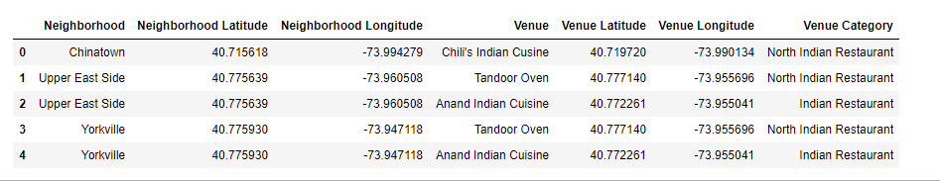
Data Used
Foursquare Api allowed us to get the respective x,y coordinates

Slide 5
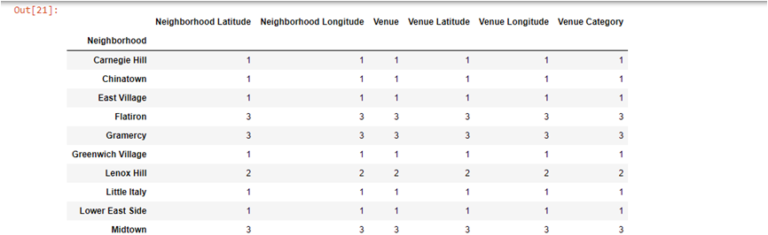
Methodology
Foursquare API is used to explore neighborhood in Manhantann,NY

Slide 6
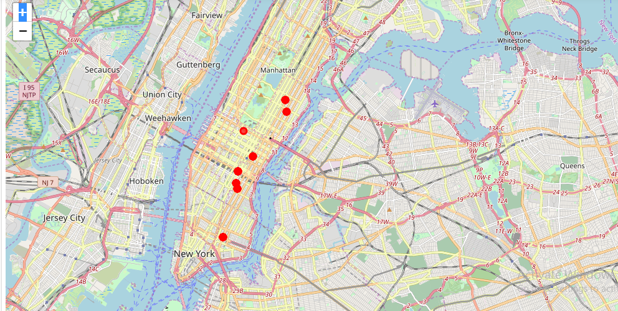
Methodolgy

Slide 7
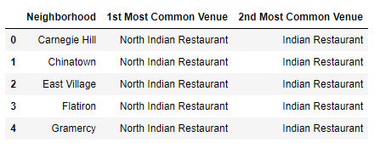
Methodology
Grouped the neighborhood into K-mean cluster

Slide 8
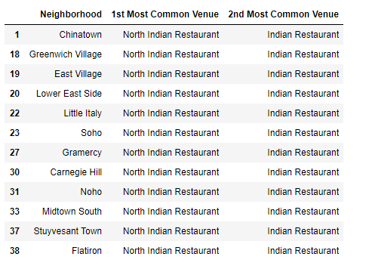
Methodology
Used K mean cluster to get data with least number of North Indian Restaurant.
Cluster 0

Slide 9
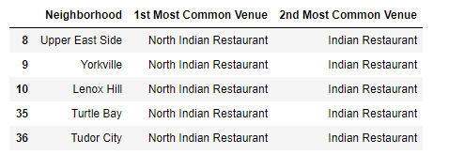
Methodology
Cluster 1

Slide 10


Result
Cluster 2
Cluster 3

Slide 11
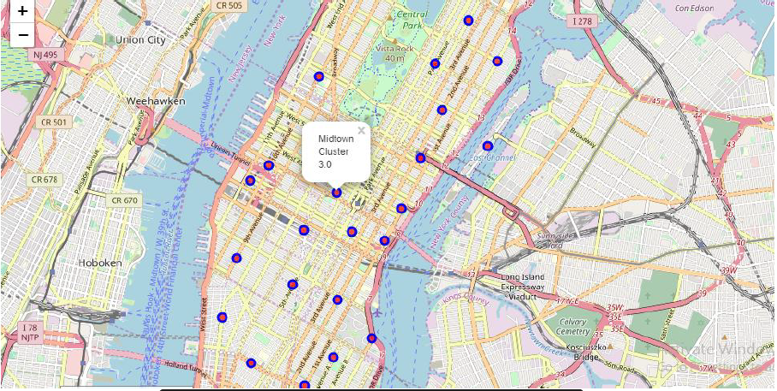
Result

Slide 12
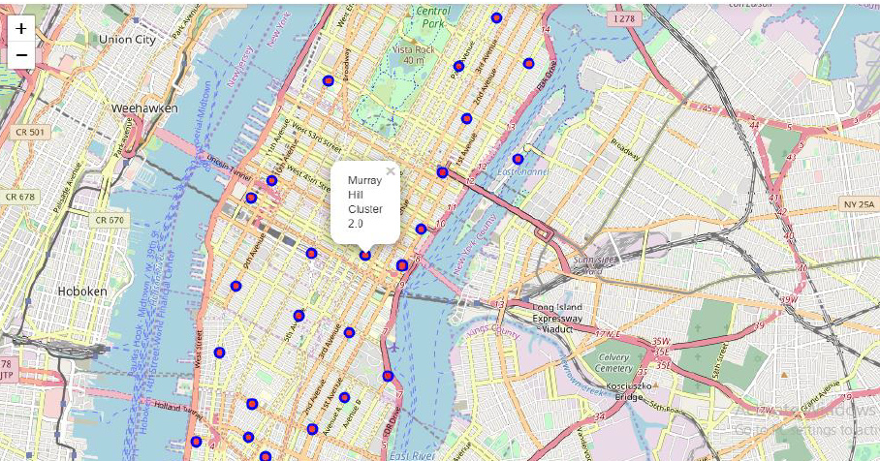
Result

Slide 13
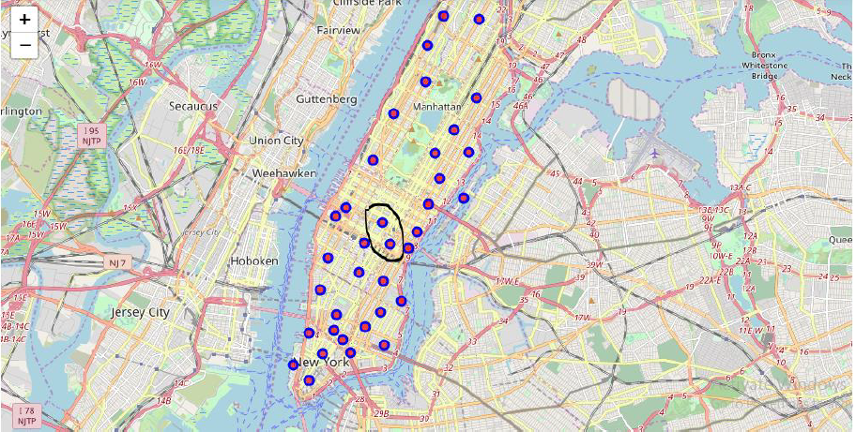
Result

Slide 14
Result
Based on the output generated Cluster 2 (Murray Hill) and Cluster 3 (Midtown) areas are the best places to open a new North Indian Restaurant business.

Slide 15
Discussion
In this section, I would be discussing the observations I have noted and the recommendation that I can make based on the results.
This analysis is performed on limited data. This may be right or may be wrong. But more the data better can be the accuracy. Foursquare API greatly helps in terms of spatial or location data.

Slide 16
Conclusion
With the available data a result has been achieved to open North Indian style restaurant. This can be a good potential for business with less risk and more profit.

